Slide 1
EMT Just In Time Training Modules, COVID-19
Layout and Planning of Community Facilities

Slide 2
Learning Outcomes
Outline the key characteristics of COVID community facilities
Identify the main site selection factors to consider
Describe the main components of readiness for COVID community facilities
Apply relevant design calculations

Slide 3
1.
Variables that impact on the design of community facilities

Slide 4
Variables that Impact on the Design of Community Facilities
Purpose of the facility within the local / national strategy
Patient typology (contacts, suspected, confirmed moderate, severe, critical or step-down)
Expected bed capacity
Existing vs new structure
Construction

Slide 5
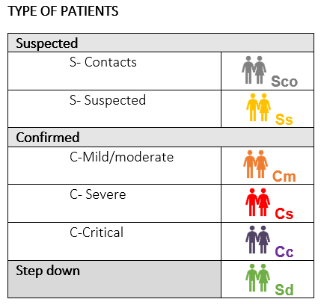
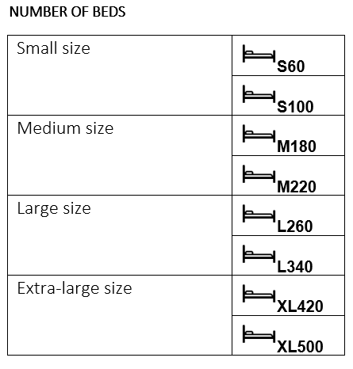
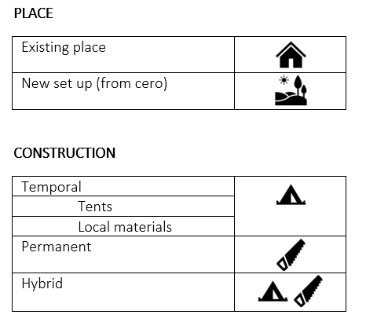
Variables that Impact on the Design of Community Facilities
Notes:
Proposed models can be situated within an existing community setting such as a soccer/football field, sports stadium, convention centre, event hall or warehouse. This setup can be used for isolating contacts, suspected and probable patients and manage confirmed cases with mild or moderate disease severity without risk factors, from the moment that regular healthcare facilities do not have the capacity anymore to serve COVID-19 patients or based on local/national strategy. In any case there should be rapid access to health advice, e.g. by an adjacent COVID-19 health post, via telemedicine, or other modality. As mentioned, there are several variables that would determine the final considerations for establishing community facilities and treatment centres, the proposed model intends to cover all potential combinations of those variables providing a wide set of potential configurations.

Slide 6
2.
Describe the main components of readiness for COVID community facilities – the 4 S’s

Slide 7
The 4 S’s
Staff
Supplies
Structure
Systems
Notes:
Staffing patterns should be pre-established to ensure effective coverage and shifts should be monitored to ensure compliance.
Assignment of insufficient staffing could impact the ability to effectively deliver services over time
WHO Euro region has developed a suite of complimentary surge calculators, including two for health workforce
https://www.who.int/docs/default-source/coronaviruse/covid-efst-v1-2.xlsx?sfvrsn=ef11cc11_2&ua=1

Slide 8
The 4 S’s
Staff
Hospital manager
Senior Medical Officer
Nursing Manager
Operational support Lead
IPC/WASH-lead
Optional: supply chain manager, staff health doctor, pharmacist
Medical Doctors
Head nurses (1/ward)
Ward nurses
Technical Team
Cleaners and helpers
Laundry staff
Waste Management Team
Laboratory
Nurse Assistants
Rehabilitation Professionals
Rapid Response Team
Screening and Triage
Psychosocial Support staff
Kitchen staff
Security guards
X-Ray
IPC/WASH TEAM

Slide 9
The 4 S’s
Staff
Supplies
Structure
Systems
Notes:
In terms of development and maintenance of medical and operational support services, substance is composed of equipment and supplies, including medical equipment, consumable medical equipment, pharmaceuticals and nonmedical supplies needed to provide clinical care in line with the Community facility treatment center patient profiles and services provided and taking into consideration logistics and other possible constraints
WHO European region has developed a suite of complimentary surge calculators, including one that provides specific, focused outputs, including detailed quantifications of equipment and consumables.
https://www.who.int/docs/default-source/coronaviruse/covid-efst-v1-2.xlsx?sfvrsn=ef11cc11_2&ua=1

Slide 10
The 4 S’s
Staff
Supplies
Structure
Systems
Notes:
Main building blocks for proposed centre layout are composed of a core area including operational support and coordination area, screening and triage area, variable 40 beds or 20 beds wards, plus 1 block of 20 beds that can be used for Specific Inpatient Profile Area (SIPA) for children or people requiring specialized or ICU care. Also allows separation of areas for suspected and confirmed patients without crossing of patient and staff flows
EMT Secretariat developed a Structure and support systems calculators, that provides specific, focused outputs, including detailed quantifications of structures and operational support components needed

Slide 11
The 4 S’s
Staff
Supplies
Structure
Systems
Notes:
In terms of policies, standard operating procedures and protocols that define the operating model of each community facility treatment centre, support systems, the ability and the limitations in implementing standards on quality of care and the interaction with other systems.

Slide 12
The 4 S’s Cross-cutting Operational Support Considerations
Waste management
Sanitation
Hygiene
Environmental cleaning
Dead body management
Laundry
Fire safety system
Electricity/illumination
Communication
Decentral stocks and restocking
Food distribution
Oxygen system
Air flow Ventilation system
Water supply

Slide 13
3.
Identify the main site selection factors to consider

Slide 14
Site Selection – Main Considerations (A)
Location:
Patient access
Security
Infrastructure
Notes:
Strategic location, nearby or well communicated with the health facility
Nearby urban hubs
Communications
Accessible for pedestrians and vehicles (e.g. ambulances, trucks, public transport)
Avoiding security hazards (e.g. nearby crowds)

Slide 15
Site Selection – Main Considerations (B)
Flexibility
Wide spaces
Accessibility
IPC friendly
Parking
Storage
Notes:
Flexibility: capacity to adapt the space for different uses.
Wide spaces: big spaces (wide and high ceiling) without obstacles
Accessibility: Entries, circuits and spaces accessible for population
IPC friendly
Parking: areas for vehicles or logistic uses
Storage: areas to store safety and in good conditions (clod, dry, clean) different items: medical, logistic, technical

Slide 16
Site Selection – Main Considerations (C)
Comfort
Privacy
Roofing
Flooring
Materials
Support areas and services
Notes:
Comfort: Adequate places to work, offices, rooms, outdoor places
Privacy: Possible areas for private activities (meetings, rest, psychological support, etc)
Roofing: Consider if the place is cover or in case of not, if could be
Flooring: A proper material on the floor for adequate cleaning and disinfect and maintenance
Materials: The surfaces can be easily cleaning and disinfected
Support areas and services: laundry, kitchen, security, maintenance, etc

Slide 17
Site Selection – Main Considerations (D)
Additional factors if using an existing structure:
Consider the state of existing services/facilities:
Allow the possibility to install new facilities: WC, showers, kitchen, etc
Allow installing other systems: medical equipment (Oxygen, X-Ray, call for nurses)
Allow a potential increase the existing facilities: Waste, Electricity, Fire system, etc.
Notes:
Consider the state of existing services/facilities:
Water (quantity and quality)
Sanitation: drainage grey and black water
Toilettes and showers
Electricity and illumination
Communication
Area for waste management
Fire system
Climatization
Security

Slide 18
Site Selection – Main Considerations (E)
Additional factors if using an existing structure (cont):
Impact on long term
Dismantle without harm
Capacity to give accommodation for staff
Human resources
Community acceptance
Notes:
Human resources: companies or assembly teams with which they are used to assemble and disassemble, laundry service, catering service, security service, etc

Slide 19
Site Selection – Main Considerations (F)
 | Main advanteges | Main disadvantages
Exhibitions halls Congress venues Events places | Communication Logistics Extra support services | To add new systems or facilities
Sport pavilion | Location Communication | Size can be not enough
Stadiums Sport fields | Size IPC friendly | Lack of roofing Floor not appropriate
Hotels Resorts | Comfort Extra support services | No visual control for the staff No IPC friendly No good conditions for logistic
Warehouses | Big space Easily adaptable Easily to implement facilities | Location No comfort condition
Airports and ports | Big size Good communications Extra support services | Location

Slide 20
Quantitative Scoring Exercise
In your groups:
Apply the quantitative scoring tool to assess the factors involved in site selection
 | Location | Size | Physical characteristic | Flexibility | Facilities | IPC friendly | Logistic characteristics | Comfort
Exhibitions halls Congress venues Events places
Sport pavilion
Stadiums Sport fields
Hotels Resorts
Warehouses
Airports and ports

Slide 21
Main factors to consider when selecting a potential location for setting up COVID19 Community facilities
 | Location | Size | Physical characteristic | Flexibility | Facilities | IPC friendly | Logistic characteristics | Comfort
Exhibitions halls Congress venues Events places
Sport pavilion
Stadiums Sport fields
Hotels Resorts
Warehouses
Airports and ports

Slide 22
4.
Building the Facility

Slide 23
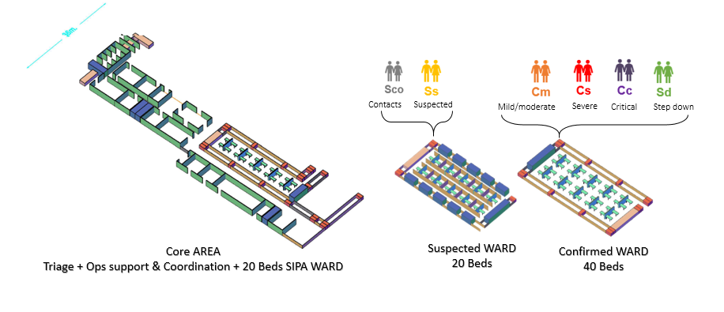
Main Building Blocks
Main building blocks for proposed centre layout are:
A core area including operational support and coordination area
Triage area
Variable 40 bed or 20 bed wards, plus 1 block of 20 beds that can be used for Specific Inpatient Profile Area (SIPA) for children or people requiring specialized or ICU care

Slide 24
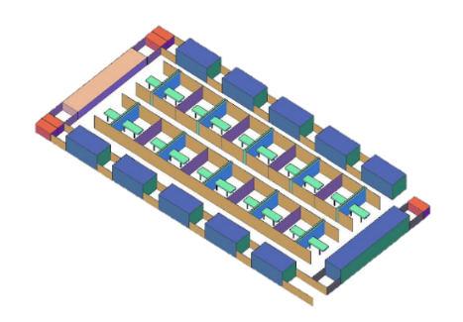
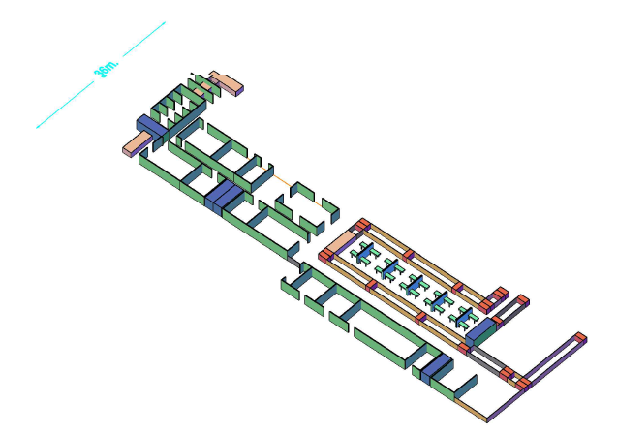
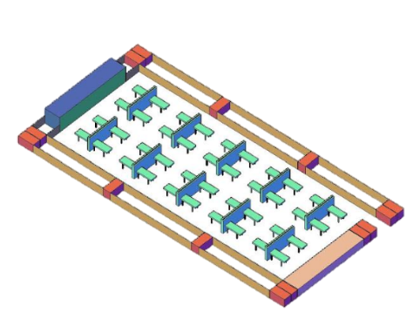
Main Building Blocks
Example of a 180 Bed Layout
Suspected
2x
2x
1x
Suspected WARD
20 Beds
Confirmed WARD
40 Beds
SIPA WARD
20 Beds
Core AREA
Triage + Ops support & Coordination
Confirmed
SIPA
Mild/moderate

Slide 25
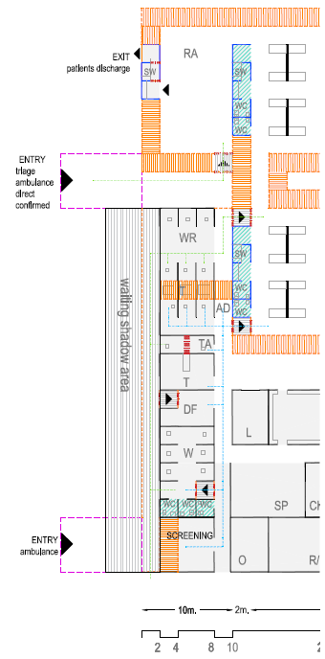
Clinical Aspects
COVID19 Screening & Triage
Notes:
All health facilities, no matter the configuration, should introduce screening and triage station at the entrance of the facility.
The screening point will be the entrance point and identify those patients that fulfil the case definition of COVID19.
The triage will be the area where, according to the triage-system chosen at the facility level, the acuity level of the patient will be defined.
The area will have a reception area waiting room with independent cabins, and a sample area to collect testing.

Slide 26
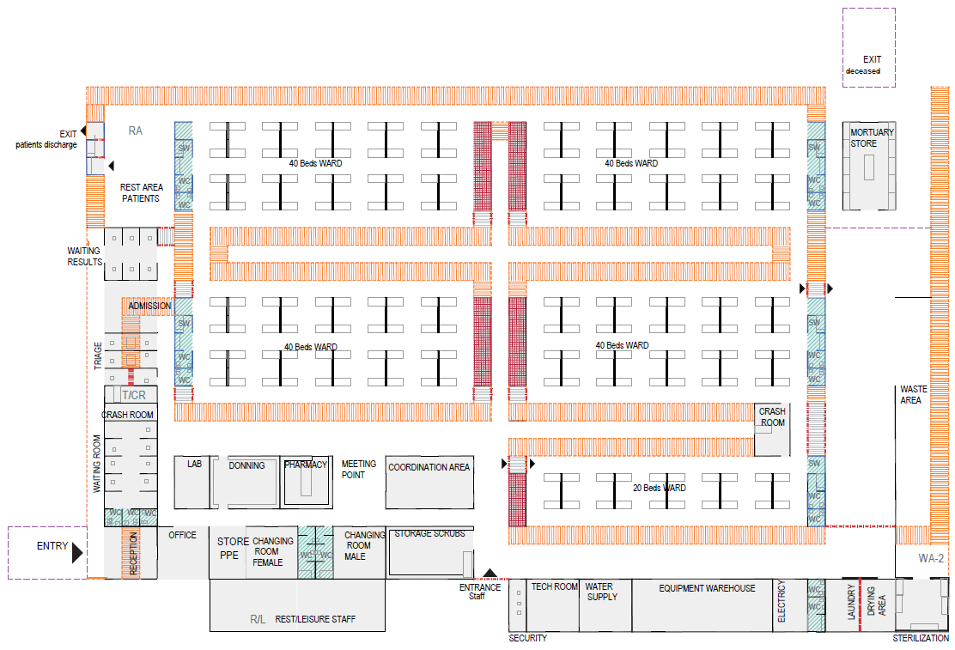
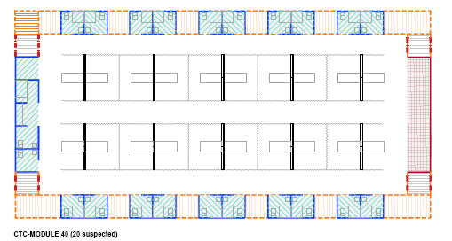
Main Building Blocks

Slide 27
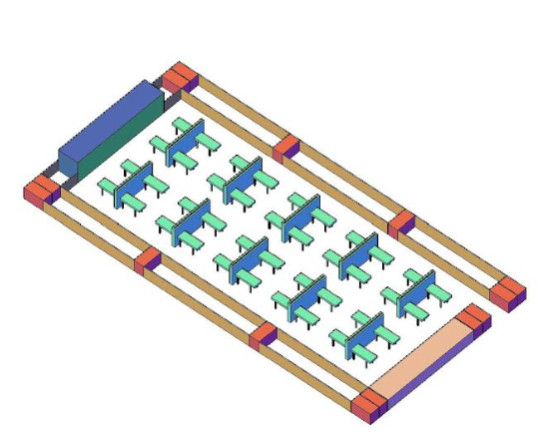
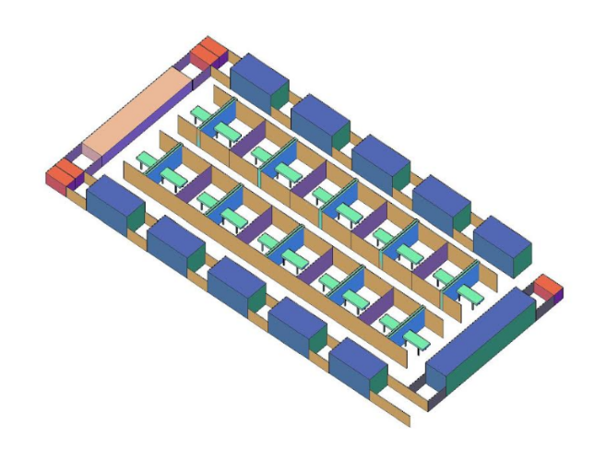
Modular Approach
The modular approach enables community facilities and treatment centres to ADAPT to diverse needs and requirements – e.g. space availability, number of patients, local conditions & security.
Modules can also be adapted to function within, and/or, augment EXISTING health facilities.
40 Beds WARD Confirmed
20 Beds WARD Suspected
Notes:
Modularity– the ability for areas to be expanded and/or repurposed. This area can be augmented by the addition of more modules surging bed capacities to 80, 120 or more and adapted for either suspect or confirmed cases
40 Beds WARD Confirmed
Module of 40 beds capacity in a cohorted structure for confirmed cases with two Toilets, two showers, lavatories, power supply and lighting services. Storage space available at premises This type of module can accommodate Confirmed patients of different degrees of severity: step down, mild, moderate, severe and critical. Each module is conceived for one type of gender users.
20 Beds WARD Suspected
Module of 20 beds capacity in an isolation room structure for separate case management. Independent toilets and shower for each patient, power supply and lighting services. This type of module can accommodate suspected patients waiting for results and contacts of different degrees of severity: mild and moderate, each module is conceived for one type of gender users

Slide 28
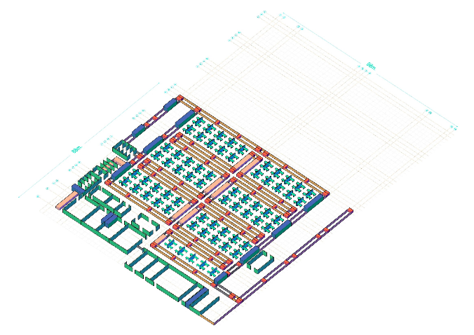
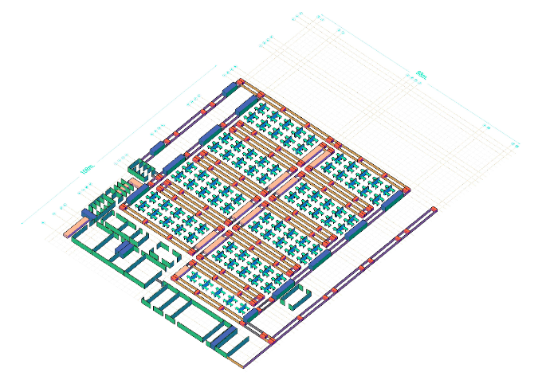
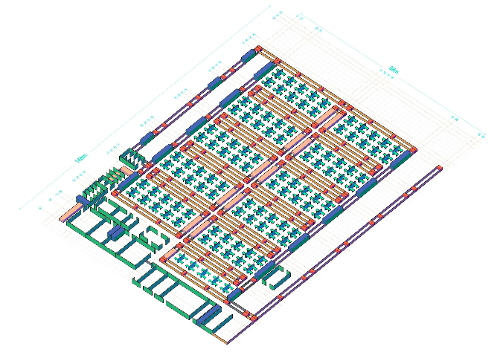
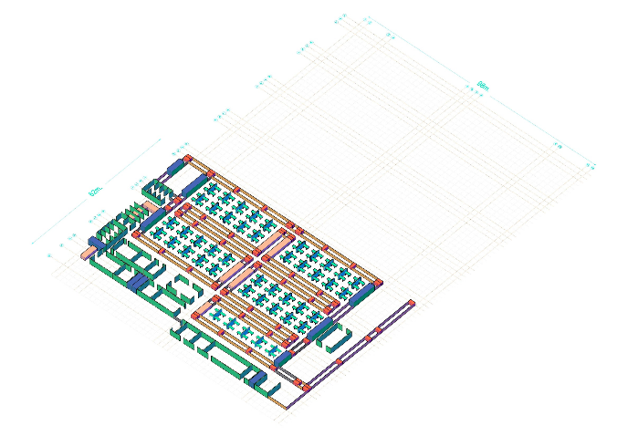
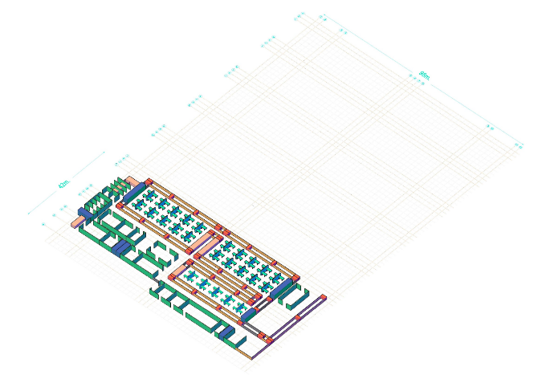
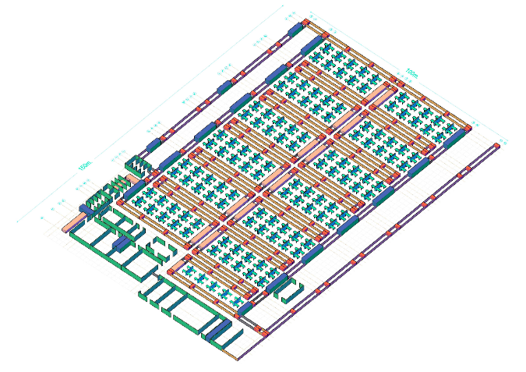
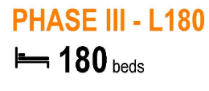
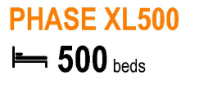
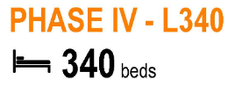
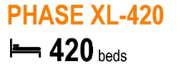
Scaling Up
Modularity also enables expansion to be planned IN ADVANCE and established IN PHASES.
Community facilities should be capable of accommodating high numbers of patients with mild and moderate case severity and equally scalable to existing community settings.
SCALING UP MODEL
Notes:
Modularity: Scaling up– enables establishment of new treatment areas while maintaining continuity of care. Figure demonstrates how to scale up a Community facility COVID-19 so that previously established modules remain functional as bed capacity is surged progressively.

Slide 29
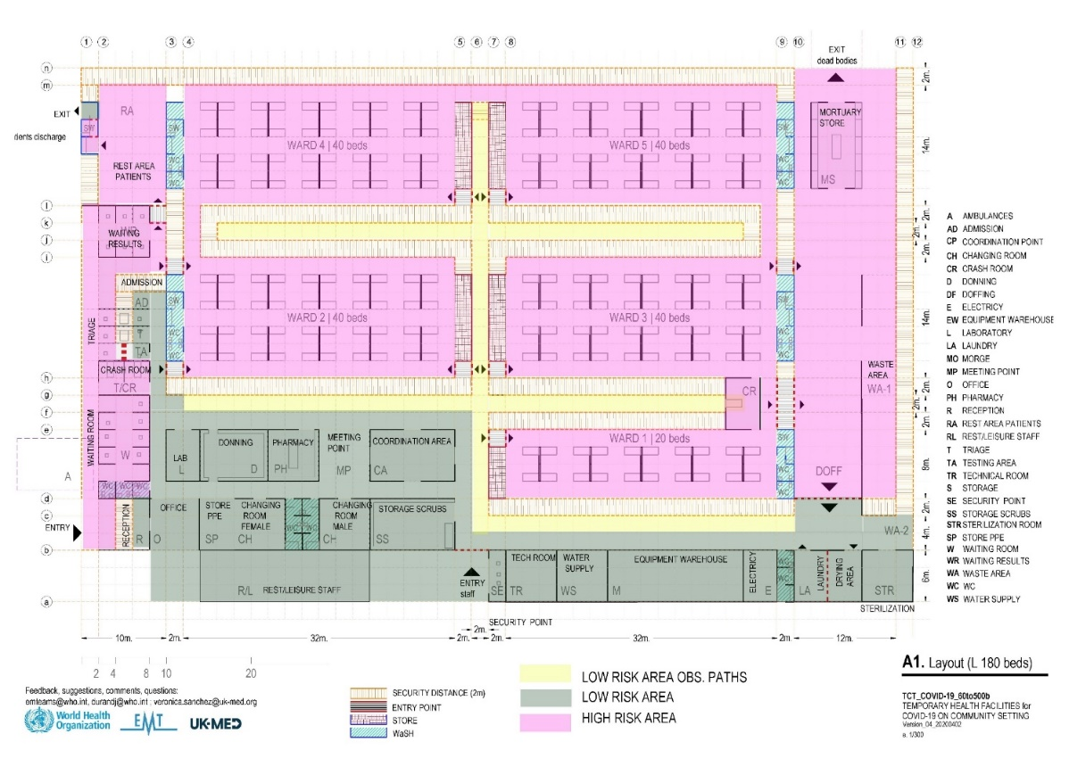
Separation
Clearly divided into distinct, exclusive areas:
A →High Risk
B →Low Risk
C →Low Risk Observation Paths
A
A
C
A
A
A
A
B
Notes:
A key characteristic of the design illustrated in figure showed is the clearly defined separation of High and Low Risk Areas with both physical barriers and security zones. Visual lines of sight between risk areas should be maintained if possible, to ensure that clinical staff can observe patients in other areas without donning or doffing additional Personal Protective Equipment (PPE). Lines of sight between risk areas:
Minimize staff time required in higher risk areas
Minimize overuse of PPE
Enable more continuous patient monitoring
As per WHO IPC COVID19 recommendations « Rational use of personal protective equipment for coronavirus disease 2019 (COVID-19) », this design allows to minimize overuse of PPE that will have a further impact on supply shortages.

Slide 30
Patient Flow
SCREENING
TRIAGE
NEEDS – WHERE - HOW
FINAL STEP
AT HOME
QUARANTINE
(NEGATIVE)
ISOLATION
(POSITIVE)
DISCHARGED
NO NEED
HOSPITALIZATION
Ss
*
TRIAGE
SUSPECTED
WARDS
MEET CASE DEFINITION
NEGATIVE
DISCHARGED
ISOLATION FOR
SUSPECTS CASES
ICU
REFERED
STEP DOWN
DECEASED
SCREENING
NEED
HOSPITALIZATION
ISOLATION
TREATEMENT
CENTRE
POSITIVE
WARDS
NEGATIVE
DISCHARGED
ISOLATION FOR
CONFIRMED CASES
ICU
REFERED
TRIAGE
CONFIRMED
DECEASED
STEP DOWN
TESTED POSITIVE
NO NEED
HOSPITALIZATION
Cm
Cs
Cc
AT HOME
NO COVID-19
SYMPTOMS
ISOLATION
DISCHARGED
Notes:
Patient flows are conceived in a separate flows for confirmed and suspected in case it is a shared facility with confirmed and suspected wards .
Flavio to cmplete
SCREENING AREA: a person presenting only with history of confirmed contact but no symptoms are sent home for quarantine (e.g. a person that assisted at home a COVID-19 patient)
HOSPITALIZATION SUSPECTED CASES TREATMENT AREA:
INCONCLUSIVE TEST: Patient with an inconclusive test (“probable case”) remain admitted in this area until further tests
PATIENT WITH POSITIVE TEST: will be transferred to confirmed cases treatment area
PATIENT WITH NEGATIVE TEST AND CLINICAL FINDINGS COMPATIBLE WITH OTHER DISEASES: they are referred to other health facilities if isolation is granted (e.g. a patient with tuberculosis)
PATIENT TESTED NEGATIVE BUT PRESENTING COVID-LIKE CLINICAL FINDINGS: they remain admitted in this area until recovered
HOSPITALISATION CONFIRMED CASES TREATMENT AREA:
Only patients with a positive lab result will be admitted here
After recovery patient can be transferred to a step down facility if available and indicated or go home
REFERRALS: Any patient in need of referral to another hospital from this facility will require proper isolation measures.
All discharges and referrals will be based on a medical decision.

Slide 31
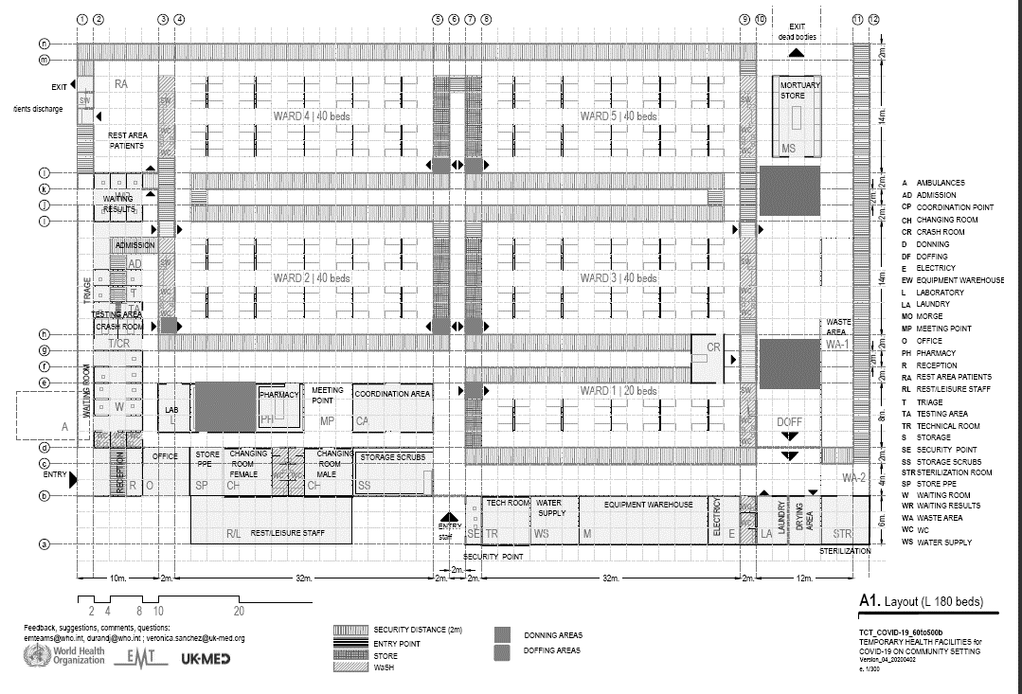
Staff Flow and Visitors
2
3
2
2
3
2
1
Visitors area
Notes:
For the best function of the centre is necessary to have some order flows with only one way and avoid crossing paths and well difference between patients, staff and visitors. Also is important to control the operational support flows with a special consideration for waste collection routes.
Staff flows
Access to Low Risk Area
Access to High Risk Area, after changing room and donning
Exit from High Risk Area, through the doffing area.
In case a scaling up of the facility would be advised to cohort staffing per every 2 wards (80 beds confirmed) for this an extra doffing area will be set up, this increase will ensure a safe scalability of the facility, allowing the possibility of compartmentalised staff for each 2 wards, so that if an incident happens it is possible to identify a specific area and a specific number of people affected and distance walked in the high risk zone would be minimised in case of large facilities. Please bear in mind that staffing and equipment will need to be outsourced for implementing this cohorting strategy
Patient flows
Figure shows the places where potential visitors can have contact with patients. This option is only advised for confirmed patients to reduce the risk of cross contamination

Slide 32
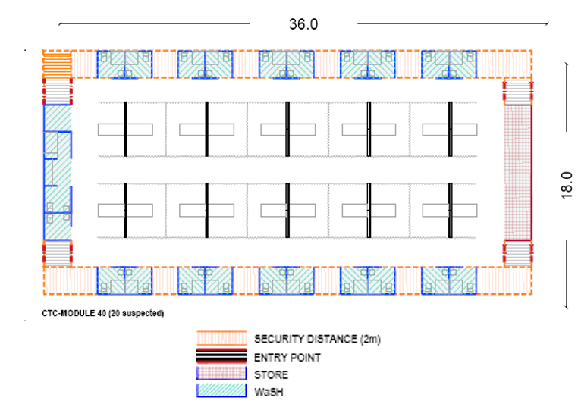
Clinical Aspects
COVID19 Isolation of contacts and Mild suspected cases WARD 20 Beds
Notes:
In certain environments it might be difficult for contacts or mildly sick patients at home. The facility will then provide individually isolation possibilities, where basic services as hygiene, food and basic healthcare are foreseen.
This means that these residents will have individual cubicles with individual sanitary facilities and showers.
Staffing levels will be lower since these patients are expected to be healthy and able to take care of themselves. A permanent presence of a medical doctor and a nurse should be considered to ensure follow up of the health of the present residents, emergency situations and care for chronic conditions.

Slide 33
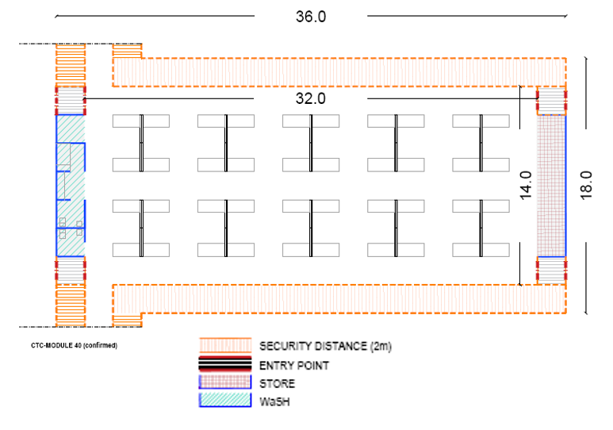
Clinical Aspects
Mild and Moderate Confirmed cases WARD 40 Beds
Notes:
These wards provide care in cohorts for 40 patients. There is no need for isolation at the individual level since all these patients are confirmed COVID19 patients. Therefore, sanitary facilities can also be shared. Since these patients are not very dependent on medical care, staffing requirements are medium.

Slide 34
Clinical Aspects
COVID19 Severe Confirmed cases WARD 40 Beds
Notes:
These wards provide care in cohorts for 40 patients. There is no need for isolation at the individual level since all these patients are confirmed COVID19 patients. Therefore, sanitary facilities can also be shared. Since these patients are severely sick, higher medical staffing levels are required.

Slide 35
Clinical Aspects
COVID19 Critical Confirmed cases WARD 40 Beds
Notes:
Critical cases are admitted in a ward area with preferably less beds to ensure enough working space around each bed.
These patients will require artificial ventilation and invasive monitoring and therefore, staffing level requirements (both in numbers and in qualifications) will be very high.

Slide 36
Clinical Aspects
COVID19 Step down cases WARD 20 Beds
Notes:
In centres where severe and ICU cases are being managed, it is essential to consider a dedicated inpatient area where recovering severe cases will be cared for an interim period. This may be known as a “stepdown area”. Recovering severe cases are likely to present with ongoing challenges that will delay safe discharge, including post-intensive care syndrome (PICS) and may require some ongoing respiratory support, but they will also require lower medical and nursing staffing ratios than severe cases

Slide 37
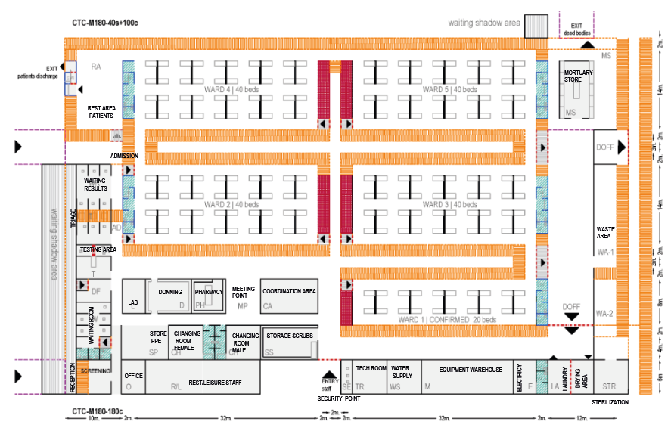
Model M 180 Beds (100x80 metres) Detailed Layout
n
o
m
d
6
4
2
2
c
5
5
4
3
l
1
h
8
3
4
2
5
5
2
4
9
7
1
6
1
i
5
a
4
8
8
b
4
9
7
5
h
8
10
3
4
6
4
5
1
2
j
3
2
k
a
b
c
d
e
f
g
1
Notes:
AREA 1 (Green) : Reception & Screening & Triage Area
Reception, screening and triage station. The screening process involves evaluation of the patient using the standardized case definition for suspected case of COVID-19. The triage system will sort the patients based on the severity of their disease
ENTRY: Patients & Ambulance
RECEPTION: Patients/ companions orientation
SCREENING: Place where the health personnel screen each patient entering facility using the standardized case definition. (keep > 1m distance
WAITING ROOM: The place where patients with symptoms wait to be taken care of by the health personnel. 7 independent cabins (2m x2m)
SAMPLE AREA: To collect testing samples from the patients
TRIAGE: 3 Separate cubicles where the health personnel determine the acuity level of patients, using a standardized, validated tool, and HCW will direct patient to appropriate section of the facility
ADMISSION: Registration and entrance for admitted patients.
RESULTS WAITING ROOM: 6 independent cabins(2x2) with separated Positions
EXIT Not admitted patients
WC(toilet): Two bathrooms (male and female) for the use of the patients during waiting and being attended to.
AREA 2 (Blue): Technical (Clinical & Ops. Support) area
Staff entry, coordination, clinical and operational supports services areas, as the main component of the core area of the facility. This area could be expandable as the facility grows in size.
Clinical
STAFF ENTRY: Entrance for clinical and operational staff, including security control point. Staff wears a mask from entry of the facility.
OFFICE: Administrative workspace for personnel.
PPE STORE: Storage location for personal protective equipment (PPE): gloves, masks, goggles, aprons and other PPE
CHANGING ROOM: Area where staff change from street clothes into scrubs and mask.
SCRUB STORAGE: Storage and distribution of work clothing to staff
BATHROOMS: Male and Female toilet, showers
COORDINATION AREA: For meetings and coordination
MEETING POINT: Place for meetings and organising the work of the personnel.
LABORATORY: To analyse samples. It is recommended this space be reserved even if such facilities are not initially required/available
PHARMACY: For storage and disbursement of medicine.
DONNING ROOM: The place where the personal protective equipment (PPE) is put on before entering the HR area.
.
Operational support
TECH ROOM: Reserved for the storage and control of technical systems and equipment. Technical personnel only
WATER SUPPLY: Control point for water storage, treatment and distribution
EQUIPMENT WAREHOUSE: Storage of spare parts, tools and machinery for technical areas
ELECTRICITY AREA: For main electrical control panels and spare parts
LAUNDRY: For washing and the disinfection of PPE and scrubs
DRYING AREA: For clothing and equipment
STERILIZATION: For reusable medical instruments and equipment
DOFFING AREA: Where personal protective equipment (PPE) are removed after leaving the high-risk area
WASTE AREA 1: For storage and treatment of infected waste
WASTE AREA 2: For storage and treatment of waste from the low risk area
REST/LEISURE STAFF: Break/on-call room for resting during shift
MORTUARY STORE: Temporary location for deceased prior to removal from COVID-19 CF&TC.
EXIT DEAD BODIES: Where deceased are transferred to burial teams or released to families or local authorities
VISITORS AREA: Area where visitors and relatives could stablish visual and verbal contact with patients
RELATIVES AREA: The place where the relatives wait for identification or for the burial.
AREA 3: Wards
The wards offer care for suspected patients in individual isolation and for confirmed patients in cohorts. They are expandable and can accommodate from 20 to 40 beds.
Inpatient area (Module of 40 beds or 20 beds)
ENTRY POINTS: For staff wearing PPE
WARDS: 40 beds or 20 beds each with gender separation
ICU Beds inside suspected cases treatment area or in confirmed patients ward when there is no dedicated ICU-ward in the facility: beds designated to patients who arrive in need of immediate invasive intervention i.e. such as central lines, intubation, catheters. POSITIVE (already confirmed) patients are directly moving to ICU from triage
WASH MODULES (WC. Shower, lavatories)
STORAGE MODULES: For consumables and other items
REST AREA for PATIENTS: Area of relaxation for admitted ambulatory patients
EXIT: for recovered patients
STAFF EXIT: Staff with PPE
Specific Inpatient Profile Area
(Module of 20 beds)
STAFF ENTRANCE: Staff with PPE
WARDS: 20 bed module
DISCHARGE SHOWER: Wash and disinfection point for recovered patients before go outside.
EXIT: for recovered patients
AREA 4: Other complementary areas
The following areas should be established or expanded to support the COVID-19 CF&TC:
CONTROL and SECURITY points
RESTING AREAS FOR STAFF
KITCHEN
LIVING ROOM
POWER GENERATION
FUEL FARM
PARKING
VISITORS AREA
WAREHOUSE EXTERNAL
SHADOW FOR EXTERNAL WAITING AREA

Slide 38
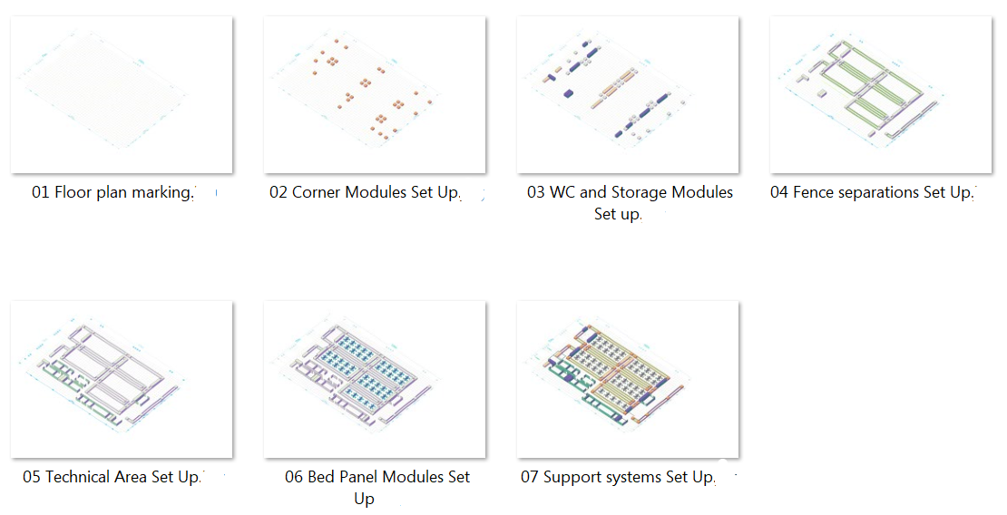
Model M 180 Beds (100x80 metres) Sequential Build Up

Slide 39
Calculations Exercises
Community Facility 180 Beds layout
Core AREA
Triage + Ops support & Coordination
2x
2x
1x
Suspected WARD
20 Beds
Confirmed WARD
40 Beds
SIPA WARD
20 Beds
?
Exercise Steps:
Produce a Layout according to the description (Use printouts)
Calculate dimensions (Use annexes)
Calculate Structures, Staff, Stuff and Drugs (Use excel BoQ tools)
Determine a suitable location based on dimensions (using proposed .kml files)

Slide 40
Calculations Exercises
Community Facility 420 Beds layout
Core AREA
Triage + Ops support & Coordination
10x
1x
Confirmed WARD
40 Beds
SIPA WARD
20 Beds
?
Exercise Steps:
Produce a Layout according to the description (Use printouts)
Calculate dimensions (Use annexes)
Calculate Structures, Staff, Stuff and Drugs (Use excel BoQ tools)
Determine a suitable location based on dimensions (using proposed .kml files)

Slide 41
Summary
EMTs can contribute surge capacity towards community facilities for the isolation & treatment of mild COVID-19 cases
There are important planning factors involved in the selection and design of such facilities Where appropriate, facilities can be scaled up and adapted to provide higher levels of care for severe and critical patients

Slide 42
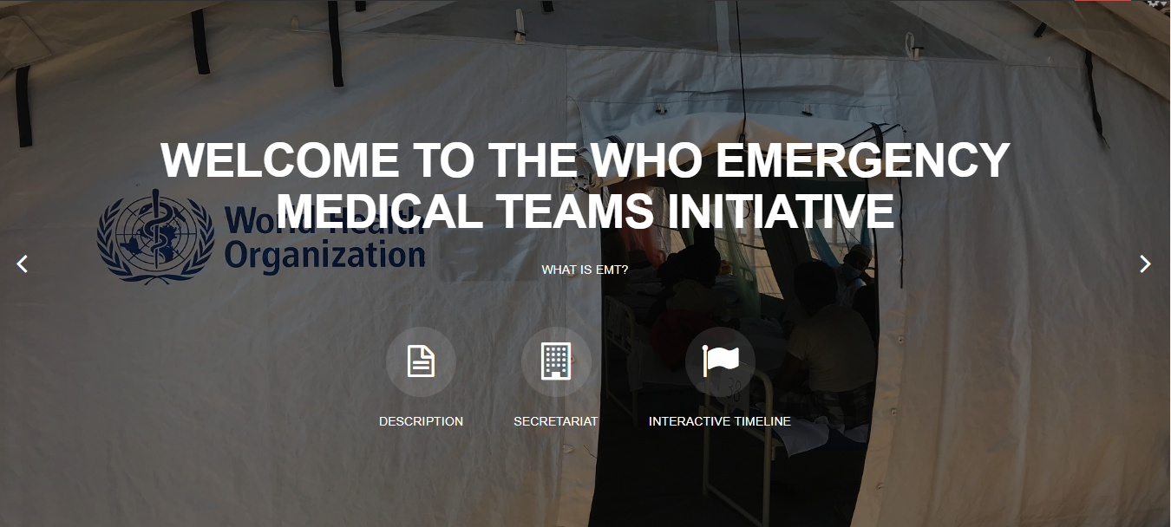
Thank you
Any questions?
For more…
http://extranet.who.int/emt/
EMTeams@who.int

